Slide 1
Find the 2nd Maximum Element in an Array

Slide 2
Method 1 :
Sort the array
Get array[1] element

Slide 3
Method 1 :
Sort the array
Get array[1] element
0 | 1 | 5 | -3 | 4

Slide 4
Method 1 :
Sort the array
Get array[1] element
0 | 1 | 5 | -3 | 4
5 | 4 | 1 | 0 | -3

Slide 5
Time complexity : O(nlogn)
Method 1 :
Sort the array
Get array[1] element
0 | 1 | 5 | -3 | 4
5 | 4 | 1 | 0 | -3
array[1]

Slide 6
Method 2:
Complexity Analysis:
Time Complexity: O(n). Two traversals of the array are needed.
Auxiliary space: O(1). As no extra space is required.

Slide 7
Initialize the first as 0(i.e, index of arr[0] element
Start traversing the array from array[1],
a) If the current element in array say arr[i] is greater than first. Then update first and second as, second = first first = arr[i]
b) If the current element is in between first and second, then update second to store the value of current variable as second = arr[i]
Return the value stored in second.

Slide 8
int first,second;
first = INT_MIN;
for (i = 0; i < arr_size; i++) {
/* If current element is greater than first
then update both first and second */
if (arr[i] > first) {
second = first;
first = arr[i];
}
/* If arr[i] is in between first and
second then update second */
else if (arr[i] > second && arr[i] != first)
second = arr[i];
}

Slide 9
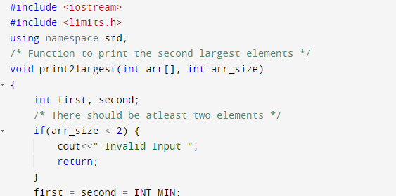
The limits.h header determines various properties of the various variable types. The macros defined in this header, limits the values of various variable types like char, int and long.

Slide 10
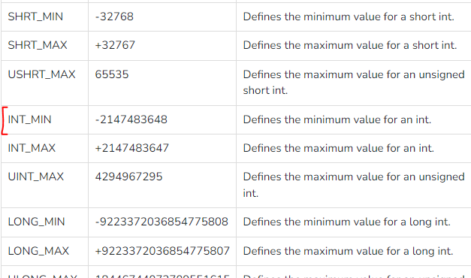
The limits.h header determines various properties of the various variable types. The macros defined in this header, limits the values of various variable types like char, int and long.

Slide 11
0 | 1 | 5 | -3 | 4
first = INT_MIN;
for (int i = 0; i < arr_size; i++) {
if (arr[i] > first) {
second = first;
first = arr[i];
}
else if(arr[i]>second && arr[i]!=first)
second = arr[i];
}
First =
Second =

Slide 12
0 | 1 | 5 | -3 | 4
first = INT_MIN;
for (int i = 0; i < arr_size; i++) {
if (arr[i] > first) {
second = first;
first = arr[i];
}
else if(arr[i]>second && arr[i]!=first)
second = arr[i];
}
First = INT_MIN
Second =

Slide 13
0 | 1 | 5 | -3 | 4
0 > INT_MIN
first = INT_MIN;
for (int i = 0; i < arr_size; i++) {
if (arr[0] > first) {
second = first;
first = arr[i];
}
else if(arr[i]>second && arr[i]!=first)
second = arr[i];
}
First = INT_MIN
Second =

Slide 14
0 | 1 | 5 | -3 | 4
first = INT_MIN;
for (int i = 0; i < arr_size; i++) {
if (arr[0] > first) {
second = first;
first = arr[i];
}
else if(arr[i]>second && arr[i]!=first)
second = arr[i];
}
First = INT_MIN
Second = INT_MIN

Slide 15
0 | 1 | 5 | -3 | 4
first = INT_MIN;
for (int i = 0; i < arr_size; i++) {
if (arr[0] > first) {
second = first;
first = arr[i];
}
else if(arr[i]>second && arr[i]!=first)
second = arr[i];
}
First = 0
Second = INT_MIN

Slide 16
0 | 1 | 5 | -3 | 4
first = INT_MIN;
for (int i = 1; i < arr_size; i++) {
if (arr[i] > first) {
second = first;
first = arr[i];
}
else if(arr[i]>second && arr[i]!=first)
second = arr[i];
}
First = 0
Second = INT_MIN

Slide 17
0 | 1 | 5 | -3 | 4
first = INT_MIN;
for (int i = 1; i < arr_size; i++) {
if (arr[i] > first) {
second = first;
first = arr[i];
}
else if(arr[i]>second && arr[i]!=first)
second = arr[i];
}
First = 0
Second = INT_MIN

Slide 18
0 | 1 | 5 | -3 | 4
first = INT_MIN;
for (int i = 1; i < arr_size; i++) {
if (arr[1] > first) {
second = first;
first = arr[i];
}
else if(arr[i]>second && arr[i]!=first)
second = arr[i];
}
1>0
First = 0
Second = INT_MIN

Slide 19
0 | 1 | 5 | -3 | 4
first = INT_MIN;
for (int i = 1; i < arr_size; i++) {
if (arr[1] > first) {
second = first;
first = arr[i];
}
else if(arr[i]>second && arr[i]!=first)
second = arr[i];
}
1>0
First = 0
Second = 0

Slide 20
0 | 1 | 5 | -3 | 4
first = INT_MIN;
for (int i = 1; i < arr_size; i++) {
if (arr[i] > first) {
second = first;
first = arr[i];
}
else if(arr[i]>second && arr[i]!=first)
second = arr[i];
}
First = 1
Second = 0

Slide 21
0 | 1 | 5 | -3 | 4
first = INT_MIN;
for (int i = 2; i < arr_size; i++) {
if (arr[2] > first) {
second = first;
first = arr[i];
}
else if(arr[i]>second && arr[i]!=first)
second = arr[i];
}
First = 1
Second = 0

Slide 22
0 | 1 | 5 | -3 | 4
first = INT_MIN;
for (int i = 2; i < arr_size; i++) {
if (arr[2] > first) {
second = first;
first = arr[i];
}
else if(arr[i]>second && arr[i]!=first)
second = arr[i];
}
5>1
First = 1
Second = 0

Slide 23
0 | 1 | 5 | -3 | 4
first = INT_MIN;
for (int i = 2; i < arr_size; i++) {
if (arr[2] > first) {
second = first;
first = arr[i];
}
else if(arr[i]>second && arr[i]!=first)
second = arr[i];
}
5>1
First = 1
Second = 1

Slide 24
0 | 1 | 5 | -3 | 4
first = INT_MIN;
for (int i = 2; i < arr_size; i++) {
if (arr[i] > first) {
second = first;
first = arr[i];
}
else if(arr[i]>second && arr[i]!=first)
second = arr[i];
}
First = 5
Second = 1

Slide 25
0 | 1 | 5 | -3 | 4
first = INT_MIN;
for (int i = 3; i < arr_size; i++) {
if (arr[3] > first) {
second = first;
first = arr[i];
}
else if(arr[i]>second && arr[i]!=first)
second = arr[i];
}
First = 5
Second = 1

Slide 26
0 | 1 | 5 | -3 | 4
first = INT_MIN;
for (int i = 3; i < arr_size; i++) {
if (arr[3] > first) {
second = first;
first = arr[i];
}
else if(arr[i]>second && arr[i]!=first)
second = arr[i];
}
-3>5
First = 5
Second = 1

Slide 27
0 | 1 | 5 | -3 | 4
first = INT_MIN;
for (int i = 3; i < arr_size; i++) {
if (arr[3] > first) {
second = first;
first = arr[i];
}
else if(arr[i]>second && arr[i]!=first)
second = arr[i];
}
First = 5
Second = 1

Slide 28
0 | 1 | 5 | -3 | 4
first = INT_MIN;
for (int i = 4; i < arr_size; i++) {
if (arr[4] > first) {
second = first;
first = arr[i];
}
else if(arr[i]>second && arr[i]!=first)
second = arr[i];
}
First = 5
Second = 1

Slide 29
0 | 1 | 5 | -3 | 4
first = INT_MIN;
for (int i = 4; i < arr_size; i++) {
if (arr[i] > first) {
second = first;
first = arr[i];
}
else if(arr[i]>second && arr[i]!=first)
second = arr[i];
}
First = 5
Second = 1
4>1 && 4!=5

Slide 30
0 | 1 | 5 | -3 | 4
first = INT_MIN;
for (int i = 4; i < arr_size; i++) {
if (arr[i] > first) {
second = first;
first = arr[i];
}
else if(arr[i]>second && arr[i]!=first)
second = arr[i];
}
First = 5
Second = 4
4>1 && 4!=5

Slide 31
0 | 1 | 5 | -3 | 4
first = INT_MIN;
for (int i = 5; i < arr_size; i++) {
if (arr[i] > first) {
second = first;
first = arr[i];
}
else if(arr[i]>second && arr[i]!=first)
second = arr[i];
}
First = 5
Second = 4

Slide 32
0 | 1 | 5 | -3 | 4
first = INT_MIN;
for (int i = 5; i < arr_size; i++) {
if (arr[i] > first) {
second = first;
first = arr[i];
}
else if(arr[i]>second && arr[i]!=first)
second = arr[i];
}
First = 5
Second = 4

